Slide 1

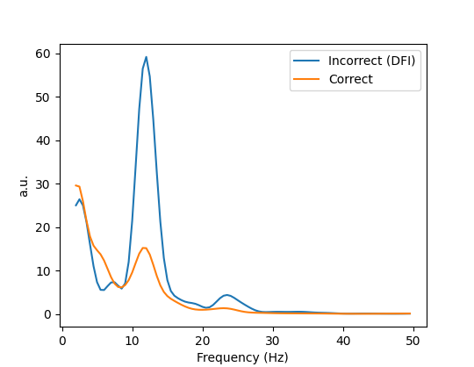
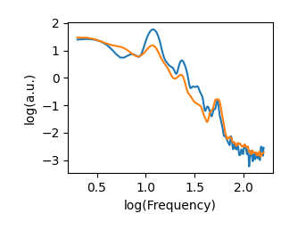
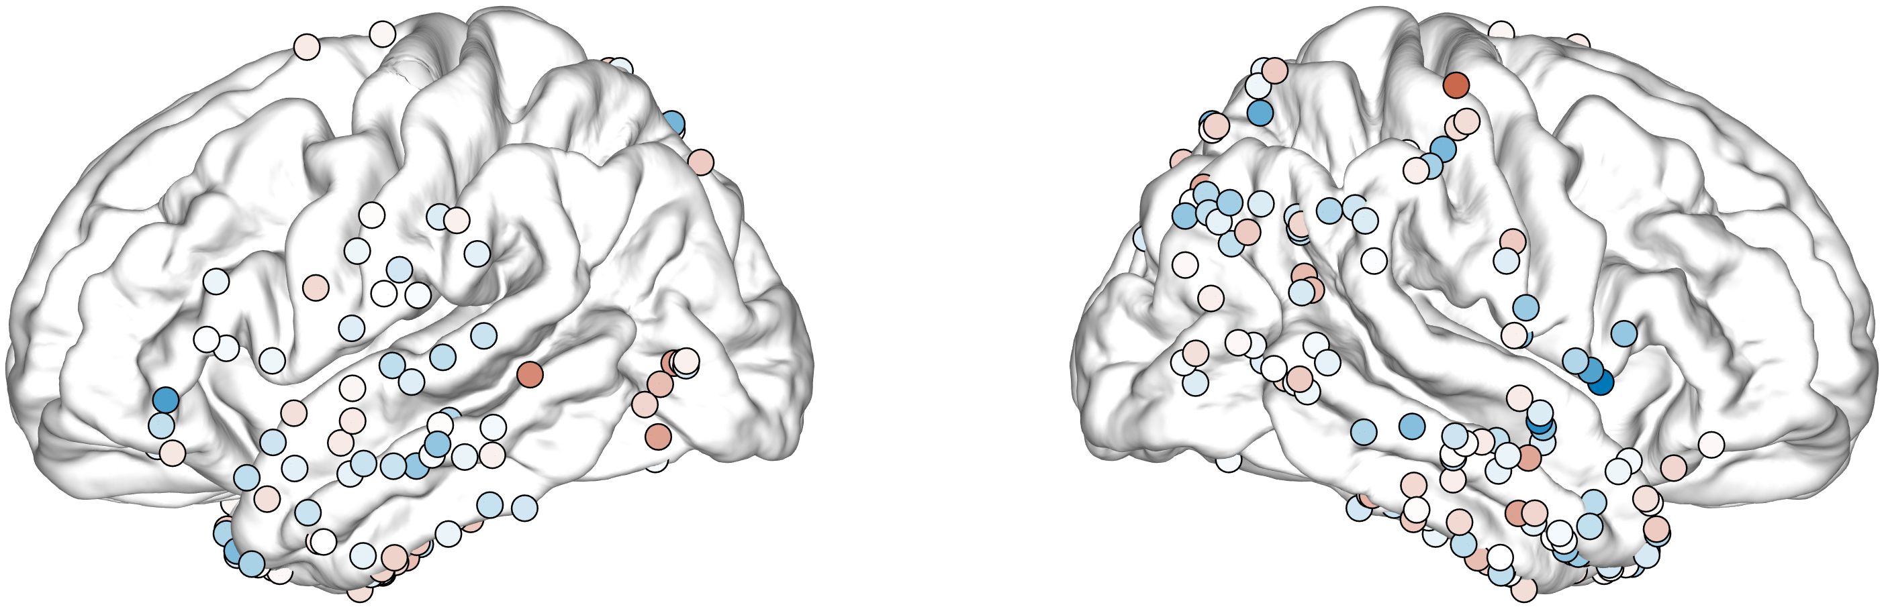
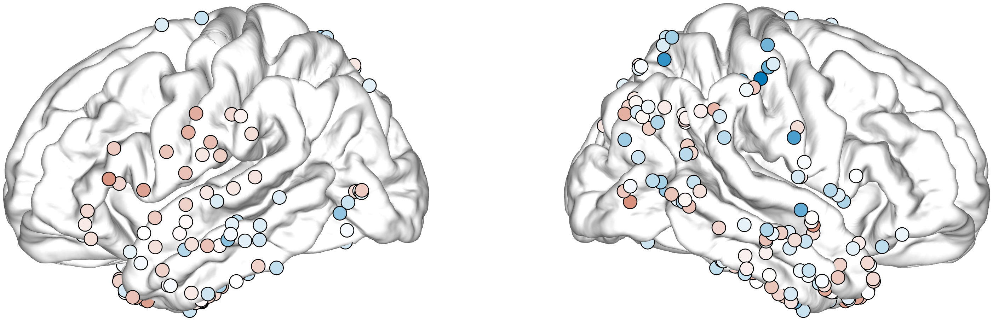
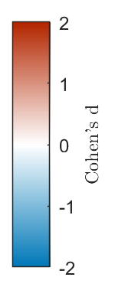
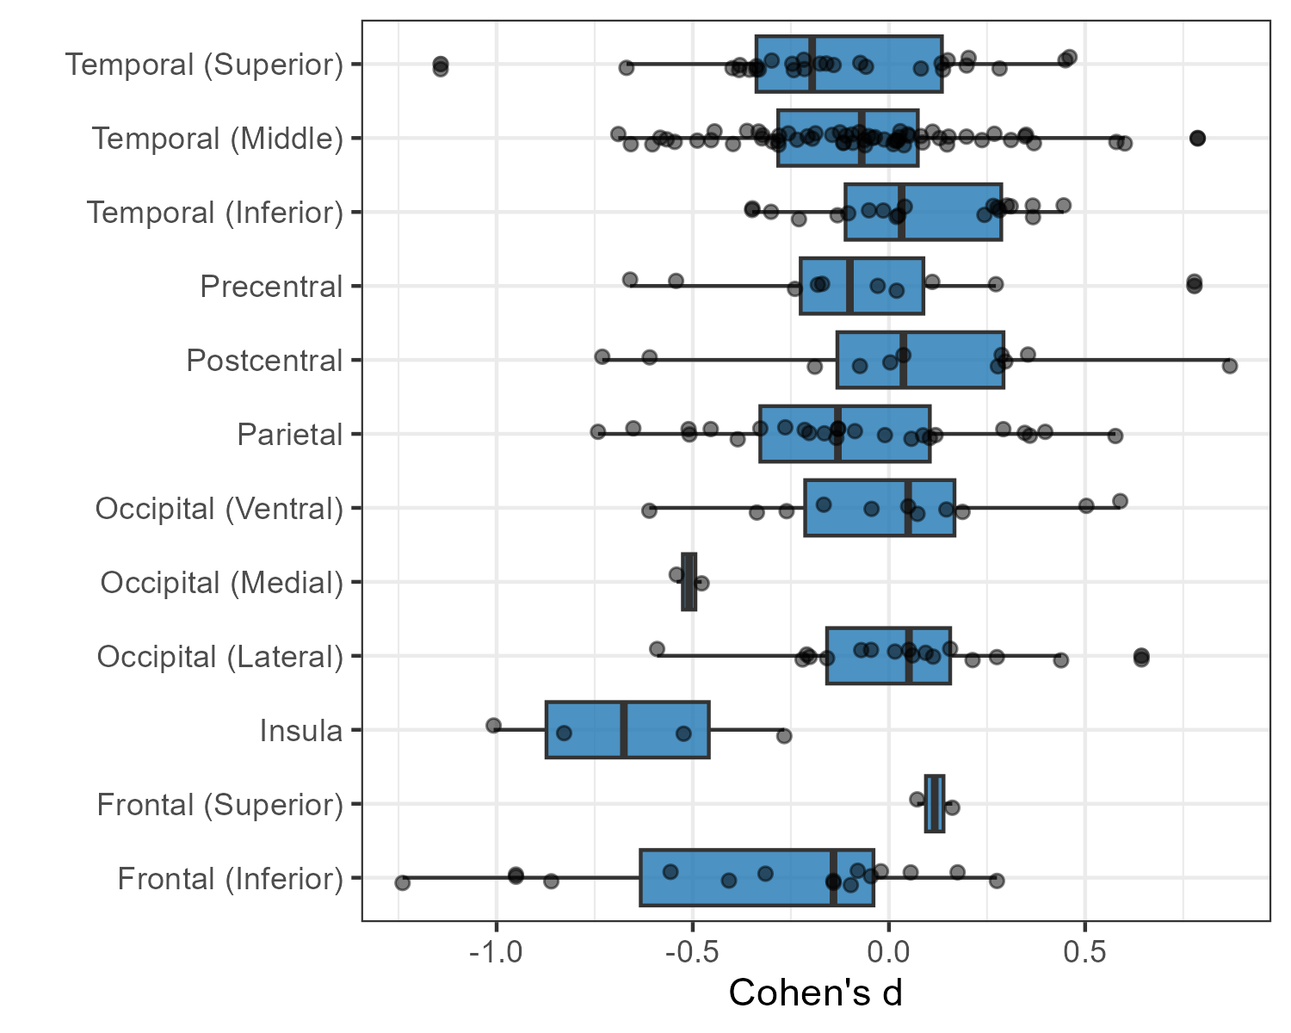
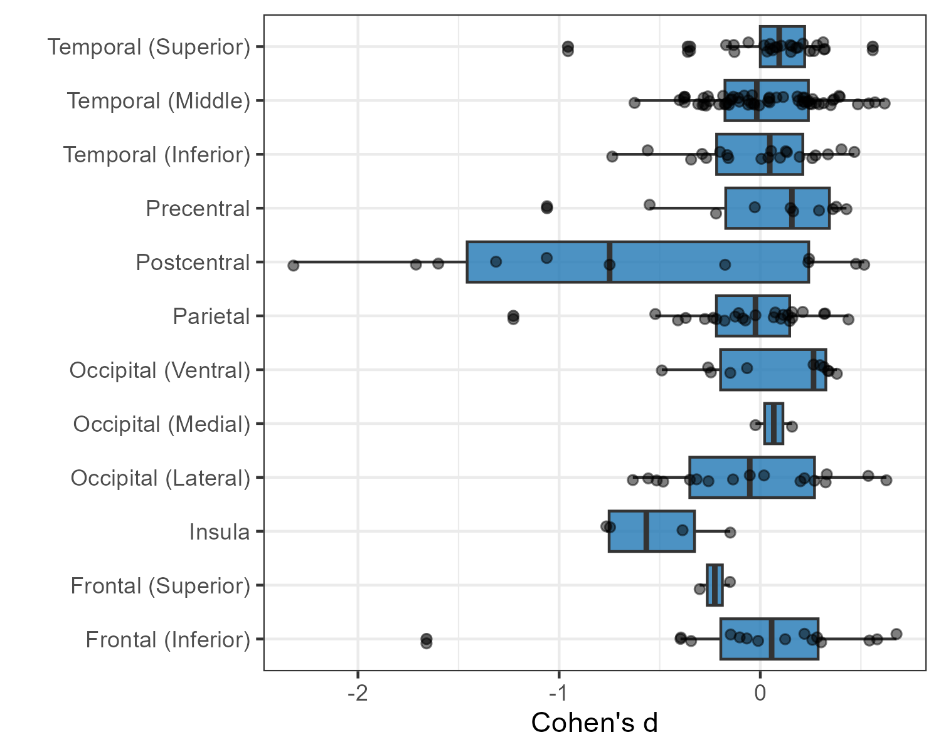
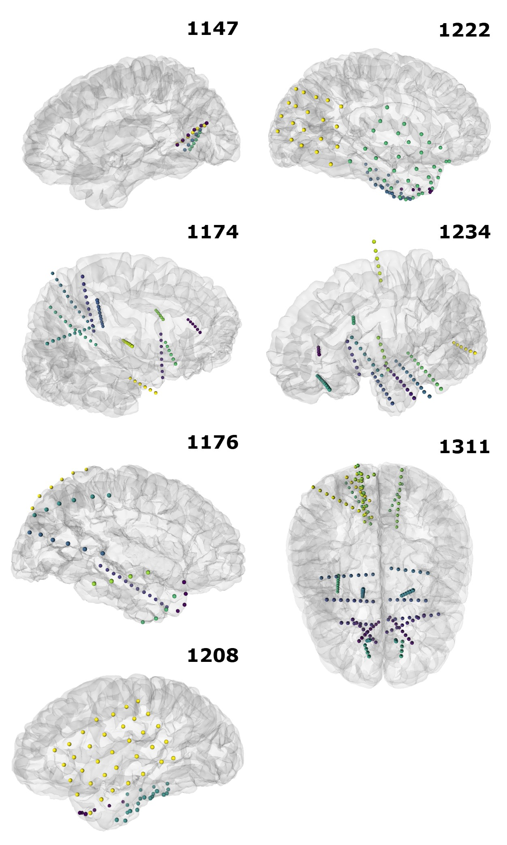
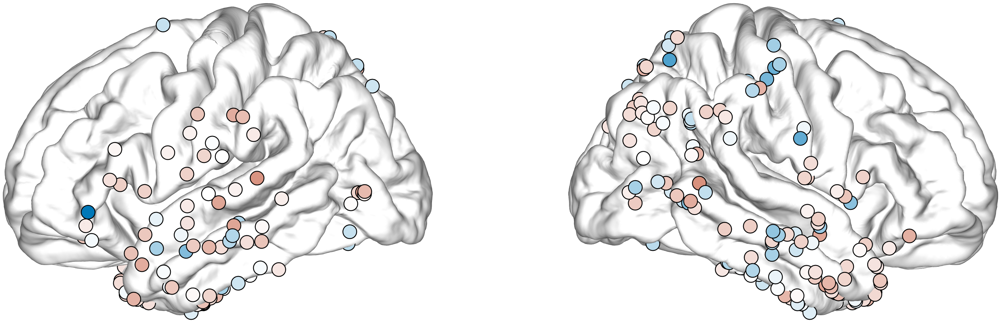
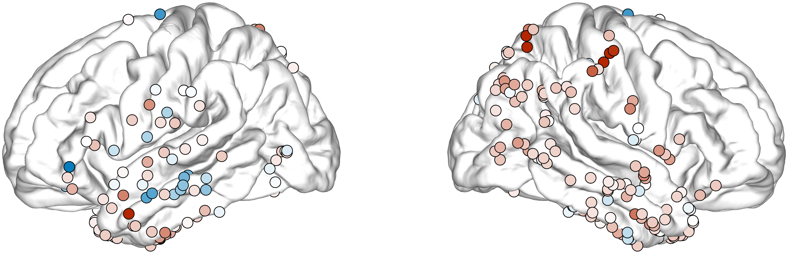
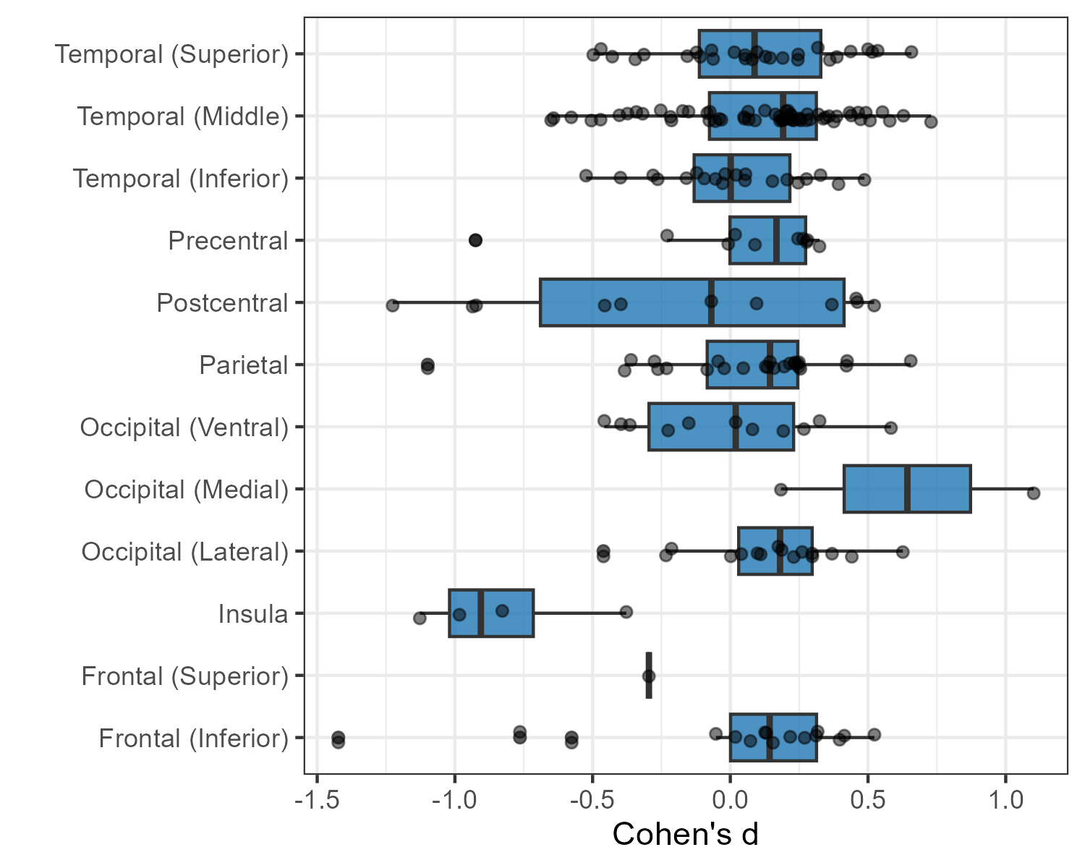
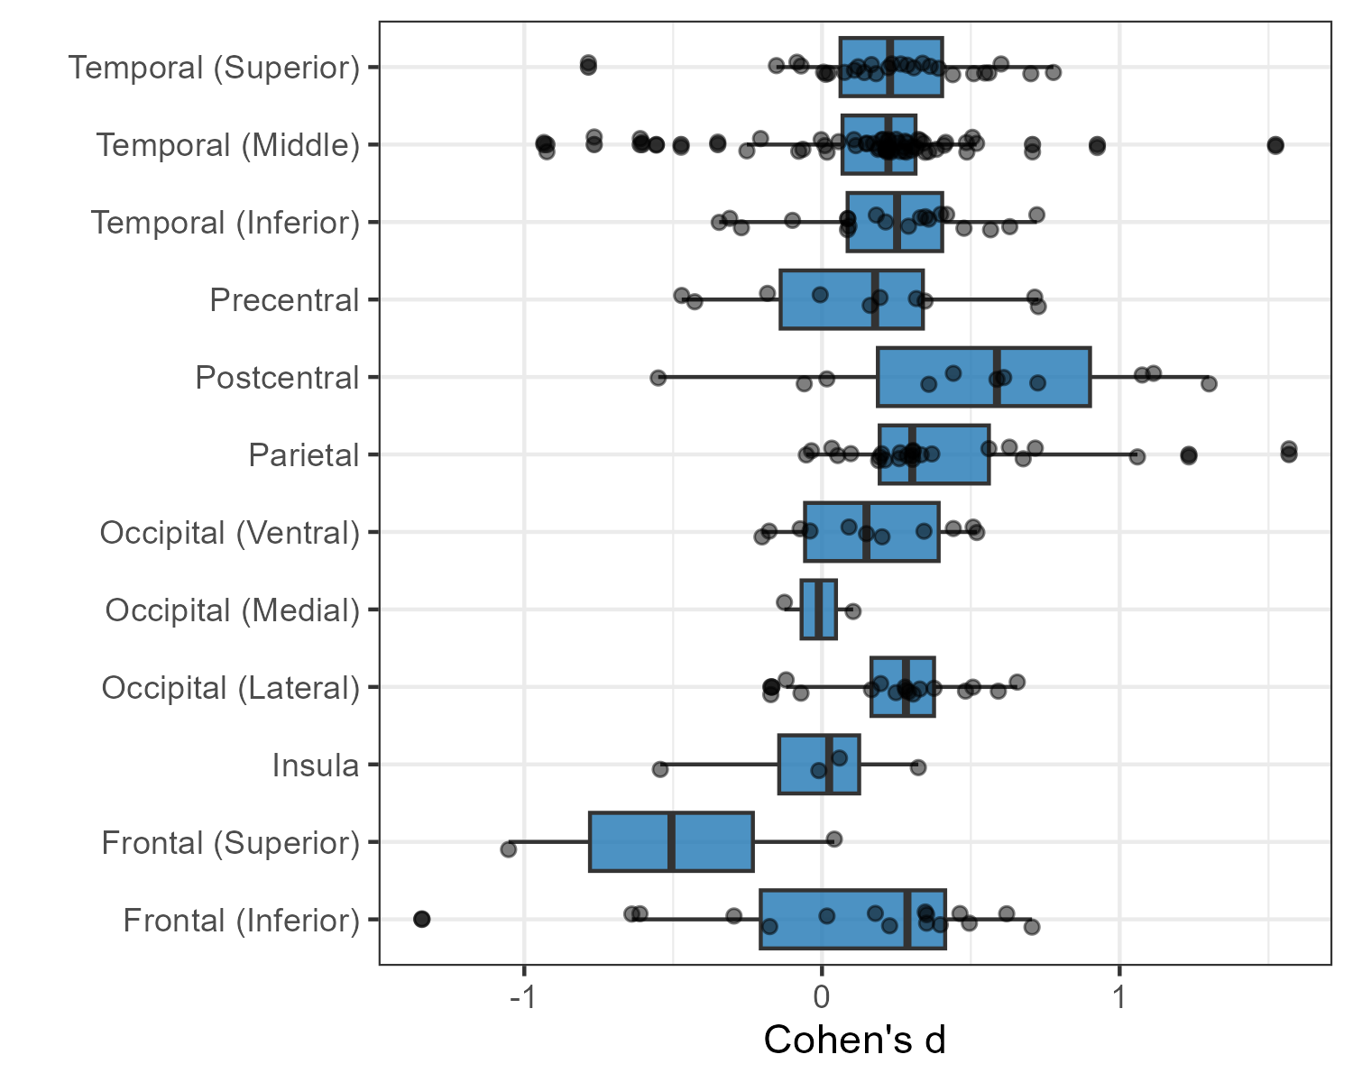
Neural Oscillations and Multisensory Integration in the Double-Flash Illusion
Ellis H. Dyke¹, Emily C. Cunningham¹ , David Brang¹
¹Dept. of Psychology, University of Michigan, Ann Arbor
Coloring indicates subject. Black dots and B% fixed effects from mixed-effects models accounting for subject-level variance.
Coloring indicates subject. Black dots and lines indicate fixed effects and 95% CI around fixed effects from mixed-effects models accounting for subject-level variance.
RESULTS
Coloring indicates subject. Black dots and lines indicate fixed effects and 95% CI around fixed effects from mixed-effects models accounting for subject-level variance.
BACKGROUND
CONCLUSIONS
The Double-Flash Illusion (DFI) shows that sounds can dramatically alter visual perception: ➔ One flash + two beeps = perception of two flashes
➔ The illusion is not always perceived, but why there are differences in perceptual experience is unclear
Spectral Analyses:
➔ Pre-stimulus (500ms) power + peak identification across alpha, beta (14-30 Hz), and high-gamma (70-150 Hz) ranges
➔ Hierarchical Modeling of trial-by-trial differences
Alpha-rhythmic frequency/power. Pre-stimulus peak alpha frequency/power were not predictive of illusory perception across participants.
One participant demonstrated robust evidence of alpha-band power-based effects, but this was not replicated in other subjects
Consistent with at least one recent report questioning the relation between alpha freq. and window of MSI
Beta-rhythmic power. No significant effects observed in any region when repeating the analysis using beta-rhythmic information
i.e., prior beta-rhythmic observations in middle temporal cortex were not confirmed here
Gamma power. Effects of HGP were predominantly observed in parietal cortex, although in the opposite direction of that predicted by prior work
i.e., reduced high-gamma power (linked to reduced excitability) for ‘fission’ trials.
Inconsistent with prior reports. Additional data will be needed to confirm and clarify this pattern.
Extract peak amplitude and auc +/- 2 Hz
“high gamma”
(auc only)
Alpha Band. No statistical differences between reports of illusion and no illusion for both alpha band frequency and power across participants.
“alpha”
“beta”
Prior EEG studies have identified several pre-stimulus patterns, especially in the alpha-band (8–12 Hz), that may indicate susceptibility
Parietal/Occipital alpha/low-beta peak frequency linked to window of MSI^{1,3}
Occipital alpha-band & high-gamma power linked to cortical excitability
➔ ↑ Alpha power (↓ gamma power) → reduced susceptibility ➔ ↓ Alpha power → increased susceptibility^{4,5}
Temporal beta-band power may predict susceptibility²
Aim. To test for the presence of these effects (EEG precursors of the Double-Flash Illusion) and examine their cortical distribution in intracranial recordings.
FDR-corrected p:
*.01-.05
**.001-.01
*** < .001
APPROACH
*
*
all n.s.
Sample. N = 7 individuals with epilepsy undergoing intracranial EEG (iEEG) recording.
Task:
➔ 4 trial types:
0 flashes, 2 beeps
1 flash, 0 beeps
1 flash-2 beeps (critical illusion condition)
2 flashes, 0 beeps
For alpha peak frequency, no consistent effects across subjects. Possible insular/frontal effects in HLM are driven by single outlying individual.
For alpha-band power, no consistent effects across subjects.
Beta Oscillatory Power.
High Gamma Power.
Overall, pre-stimulus alpha-band modulation of illusory perception in the DFI is spatially inconsistent and not reliably observed across participants, challenging the robustness of existing scalp EEG/MEG findings.
*
**
***
**
KEY REFERENCES
**
***
Cecere, R., Rees, G., & Romei, V. (2015). Individual differences in alpha frequency drive crossmodal illusory perception.
Keil, J. et al., (2020) Double Flash Illusion: Current Findings and Future Directions
Hanslmayr, S., Gross, J., Klimesch, W., & Shapiro, K. L. (2011). The role of alpha oscillations in temporal attention.
Lange, J., Oostenveld, R., & Fries, P. (2013). Reduced occipital alpha power indexes enhanced excitability rather than improved visual perception.
16.67ms
FDR-corrected p:
*.01-.05
**.001-.01
*** < .001
**
₊
+
**
Flash
…
B
Little evidence for difference in beta-band oscillatory power across subjects. Possible insular effect in HLM is driven by single individual. Possible mid. temporal effect was weak at best, and not in the predicted direction.
For high-gamma power, prestimulus differences were observed among parietal sites, with possible effects in lateral occipital and temporal sites. In all cases, increased HGP was linked to accurate responses.
Tones
10ms
(60ms)
10ms

